Slide 1







Amazon Innovations
Melike Seyitoglu
Ziya Kadir Tokluoglu

Slide 2




INNOVATIONS
Amazon Web Service (AWS)
Amazon Alexa
Sequoia and Digit

Slide 3

Amazon web service
Amazon Web Services (AWS) is a leading cloud platform that provides a wide range of on-demand services such as computing power, storage, and databases on a pay-as-you-go basis.
KEY FEATURES
Amazon Lambda: Revolutionizing Serverless Computing
Efficiency and Cost-Effectiveness with Automatic Scaling and On-Demand Pricing in Cloud Computing
Innovations in Machine Learning with Amazon SageMaker
Revolutionizing Hybrid Cloud with Amazon Outposts

Slide 4


AMAZON LAMBDA
AMAZON OUTPOSTS
enables serverless computing by automatically managing the underlying infrastructure, allowing users to run code in response to events and scale automatically, only charging for the compute time used.
extends AWS infrastructure to on-premises environments, providing a consistent hybrid experience with low-latency performance and seamless integration.
Amazon web Service (Aws)
SAGEMAKER
AUTOMATIC SCALING AND ON-DEMAND PRICING
accelerates the machine learning lifecycle with built-in algorithms, automated model tuning, and one-click deployment, making it easier for data scientists and developers to build, train, and deploy models.
allow AWS services to dynamically adjust resources based on demand and charge users only for what they use, ensuring cost efficiency and scalability.

Slide 5


DISRUPTIVE INNOVATION
AWS
The introduction of AWS cloud services disrupted traditional IT infrastructure by providing scalable, on-demand computing resources, enabling businesses to move away from costly on-premises servers.
Shifting the paradigm from traditional IT infrastructure to cloud-based services, fundamentally changing how businesses approach computing and data storage.
NEED-PULL INNOVATION
The introduction of AWS services responded to the need for scalable, flexible, and affordable IT infrastructure, allowing businesses to avoid the high costs of maintaining physical servers and data centers.

Slide 6

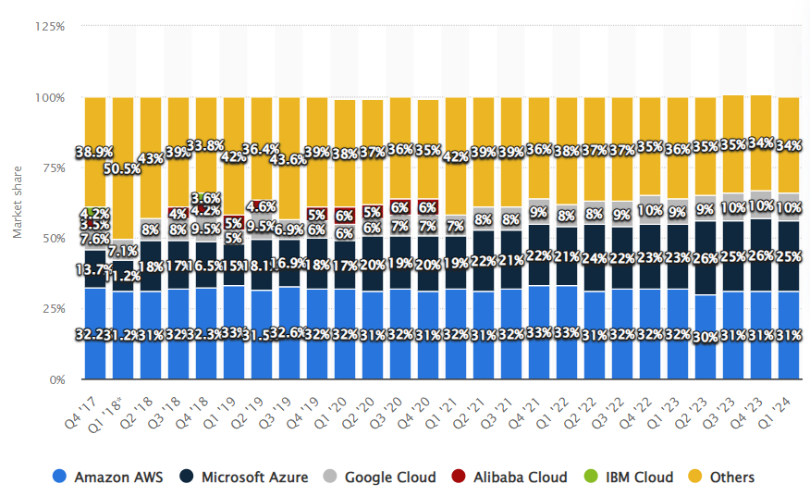
Adoption Factors and Adopter Categories for AWS
FACTORS THAT INFLUENCE ADOPTION:
INNOVATION ADOPTER CATEGORIES
Relative Advantage:
AWS provides scalable, on-demand computing resources that significantly reduce IT infrastructure costs and enhance operational flexibility.
Compatibility:
AWS services integrate with various existing IT infrastructures and development tools, making it easy for businesses to transition to the cloud.
Complexity:
AWS offers a range of services from basic to advanced, with extensive documentation and support, making it accessible to users with varying levels of expertise.
Early Adopters:
Startups and tech-savvy companies that quickly embrace cloud solutions to scale operations efficiently.
Early Majority:
Enterprises that adopt AWS after seeing the success of early adopters and recognizing the cost and efficiency benefits.

Slide 7


Profit Model and Network
Profit Model:
Offering a pay-as-you-go pricing model, allowing customers to only pay for the computing resources they use, making cloud services more accessible and cost-effective.
Network:
Building a vast network of data centers and cloud infrastructure globally, ensuring high availability and low latency for customers worldwide.

Slide 8


Amazon Alexa
is a cloud-based voice service enables users to interact with technology using natural language commands, providing hands-free control over smart home devices and access to information.
KEY FEATURES
Advanced Voice Recognition and Natural Language Processing
Integration with Smart Home Devices
Alexa Skills Kit (ASK)
Continuous Learning through Machine Learning

Slide 9

Amazon Alexa
NEED-PULL INNOVATION
Alexa was developed in response to the growing demand for smart home automation and hands-free control of devices, addressing a clear market need for convenience and integration with various smart products.
DISRUPTIVE INNOVATION
Transforming how consumers interact with technology by introducing a voice-activated assistant, disrupting traditional user interfaces like keyboards and touchscreens.
Creating a new market for smart home devices and services that are controlled through voice commands.

Slide 10
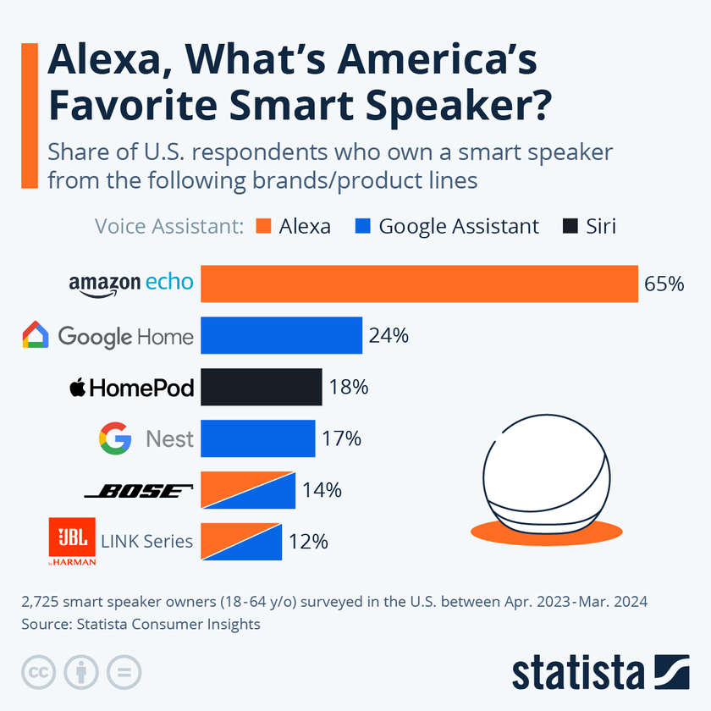
Adoption Factors and Adopter Categories for Alexa
FACTORS THAT INFLUENCE ADOPTION:
INNOVATION ADOPTER CATEGORIES
Relative advantage:
Alexa offers significant convenience by enabling voice control for a wide range of tasks, such as managing smart home devices and accessing information. This hands-free functionality simplifies daily routines and enhances user comfort, making it more efficient than traditional methods.
Observability
The benefits of Alexa are easy to observe. Users quickly see how it streamlines tasks and integrates seamlessly into their lives. Positive word-of-mouth, media coverage, and demonstrations have made Alexa's advantages highly visible, encouraging broader adoption.
Early Adopters:
Tech enthusiasts and opinion leaders who embrace new technology and influence others to follow.
Early Majority:
Users who adopt Alexa after seeing success stories and positive reviews from early adopters.

Slide 11
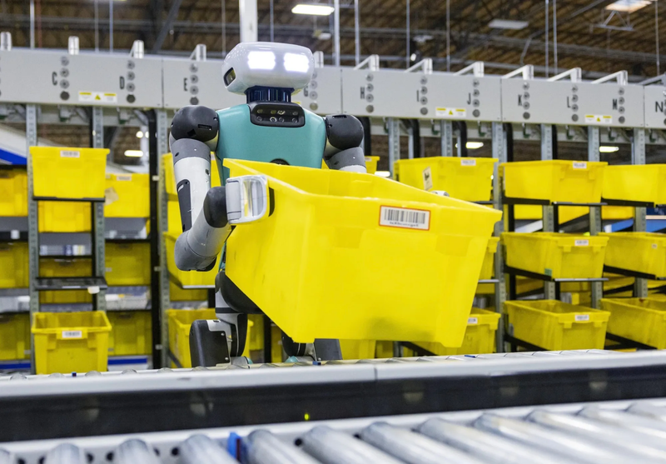
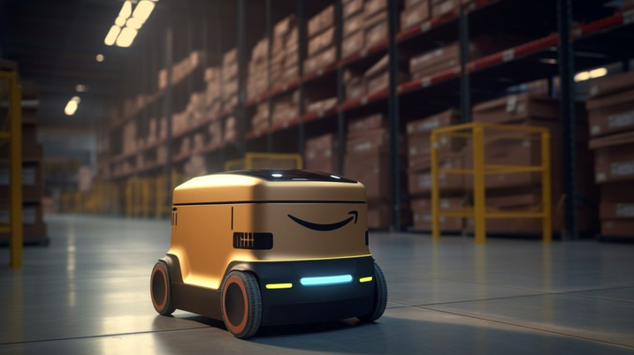
Sequoia and Digit
Sequoia and Digit are advanced robots used in Amazon warehouses to enhance efficiency and productivity.
KEY FEATURES
Automated Storage and Retrieval Systems
Bipedal Mobility
Advanced Robotics and AI Integration
Increased Efficiency and Productivity

Slide 12
AUTOMATED STORAGE AND RETRIEVAL SYSTEMS
BIPEDAL MOBILITY
Digit's bipedal design enables it to navigate complex environments with human-like agility, allowing it to perform tasks such as lifting and transporting packages in spaces that are challenging for traditional wheeled robots.
Sequoia optimizes warehouse operations by automating the storage and retrieval of items, reducing the time and effort required for manual handling and increasing overall efficiency.
Sequoia and Digit
INCREASED EFFICIENCY AND PRODUCTIVITY
ADVANCED ROBOTICS AND AI INTEGRATION
By automating repetitive and labor-intensive tasks, these robots significantly boost warehouse efficiency and productivity. This not only reduces the need for manual labor but also minimizes errors and speeds up order fulfillment processes.
Both Sequoia and Digit utilize advanced robotics technology and artificial intelligence to enhance their operational capabilities. This integration allows them to adapt to dynamic warehouse conditions and improve their performance over time.

Slide 13
Sequoia and Digit
KNOWLEDGE-PUSH INNOVATION:
The development of Sequoia and Digit robots leverages cutting-edge robotics and artificial intelligence research, enabling advanced functionalities like automated storage and retrieval and bipedal mobility.
DISTRUPTIVE INNOVATION
Their ability to create new markets, enhance efficiency, and challenge traditional methods underscores their potential to disrupt the logistics and warehousing industry fundamentally. As more companies adopt these robots, the industry is likely to experience significant shifts in operations, labor dynamics, and competitive strategies.
RADICAL INNOVATION
Sequoia's automated storage and retrieval systems revolutionize warehouse operations, replacing manual processes with advanced robotics.

Slide 14
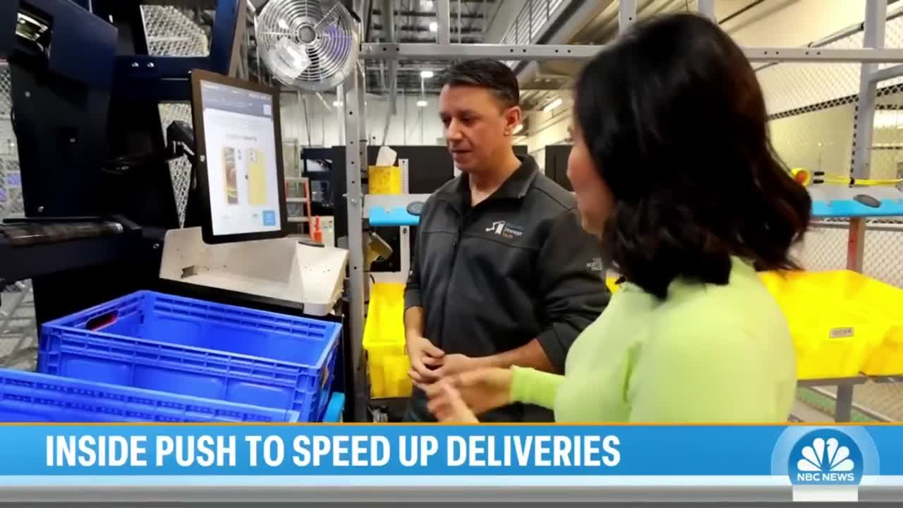
Adoption Factors and Adopter Categories for Sequoia and Digit
FACTORS THAT INFLUENCE ADOPTION:
INNOVATION ADOPTER CATEGORIES
Compatibility:
Designed to integrate with existing warehouse management systems and workflows, making them easy to incorporate into current operations.
Observability:
The operational improvements and efficiency gains provided by these robots are quickly noticeable, encouraging wider adoption.
Innovators:
Companies willing to invest early in cutting-edge technology to gain a competitive edge.
Early Adopters:
Logistics and e-commerce companies looking to optimize their warehouse operations based on proven success stories from innovators.

Slide 15
Source
https://aws.amazon.com/lambda/?nc1=h_ls
https://aws.amazon.com/outposts/
https://aws.amazon.com/autoscaling/pricing/
https://aws.amazon.com/sagemaker/
https://www.statista.com/statistics/967365/worldwide-cloud-infrastructure-services-market-share-vendor/
https://www.youtube.com/watch?v=hBY-RS8sxik
https://www.statista.com/chart/23943/share-of-us-adults-who-own-smart-speakers/
https://www.aboutamazon.com/news/operations/amazon-introduces-new-robotics-solutions
https://intuji.com/the-tech-behind-amazon-alexa/

Slide 16

Thank you

